Slide 1
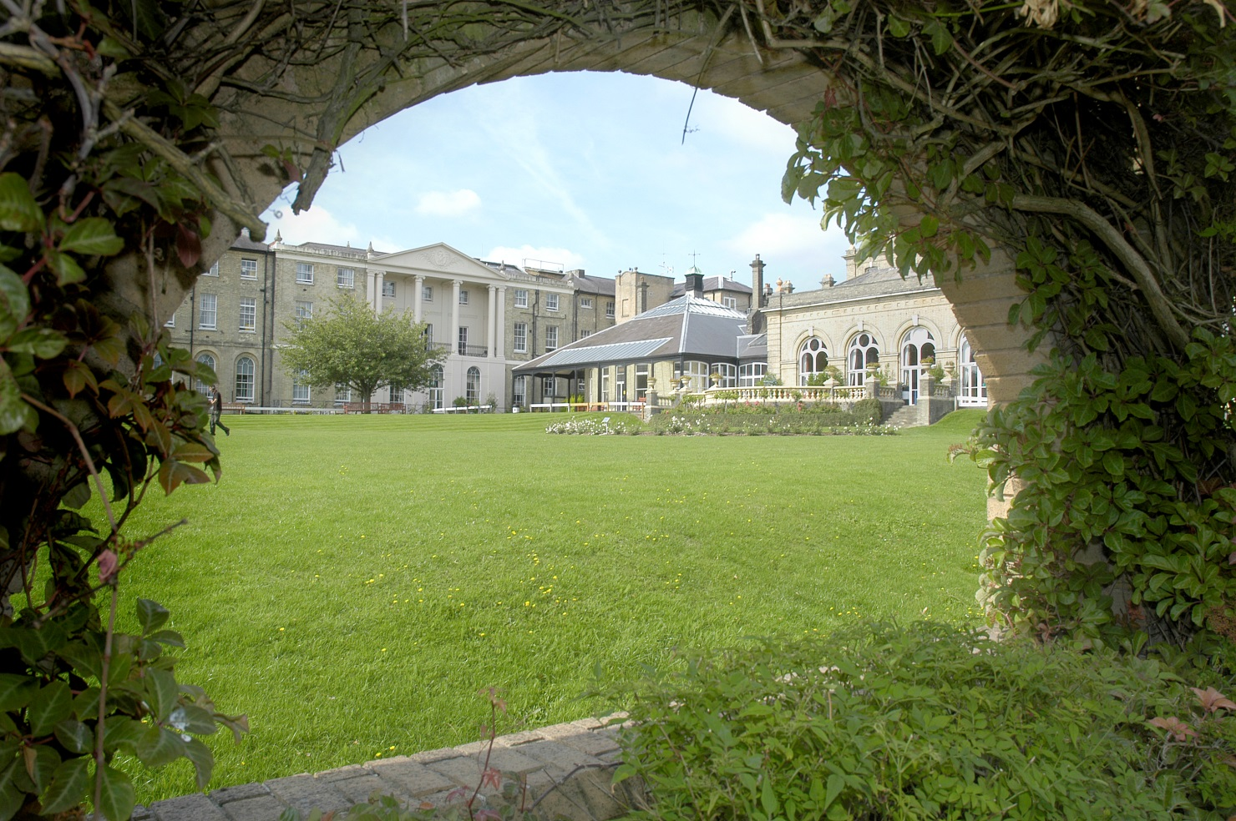
New ideas our research and innovation strategy
Royal Hospital for Neuro-disability July 2024

Slide 2

our research and innovation priorities
Understanding more
Discovering more
We are committed to discovering new interventions, support and methods of care
Sharing more
We will share our understanding, knowledge and expertise within the RHN to ensure that our practice is up to date and with others for the benefit of the wider population of people with neuro-disabilities
We are committed to understanding more about neuro-disability

Slide 3
a culture of curiosity
Our people
Our clinical teams
Our clinical teams provide the most up to date interventions, support and care by interpreting and applying the latest research findings to their practice
Our research teams
By undertaking projects and studies our research teams discover more about neuro-disabilities and the best interventions, support and care
Everyone at the RHN is aware of the value of research. They know how research helps us to understand more about neuro-disability and how it enables us to provide the best innovations, care and support

Slide 4
we will
culture
create a culture of curiosity, valuing the role of research across all our people
capability
create a sustainable multidisciplinary research capability and support post graduate and post-doctoral opportunities
collaboration
increase our collaboration with other expert units
output
increase our research output through publications, posters and presentations
Sharing at RHN
engage our colleagues in our and other’s research and share findings to ensure our practice is up to date
Sharing with the wider community
engage others in our research and share our findings so as to benefit the wider community

Slide 5
Our focus
Our focus is on areas where
there is potential benefit for our patients and residents and
we are recognised for our expertise
Our programmes
disorders of consciousness
We will also undertake research and innovation in other areas of relevance to our services
long term ventilator support
service and technology innovation
oral health and dental care

Slide 6
our research and innovation programmes
Disorders of consciousness
We are curious about the nature of consciousness and how this is affected by neurological injury.
We will explore methods of assessment and monitoring and the effect of interventions, support and care.
We will investigate prognosis, comorbidities and the quality of life of people with disorders of consciousness and the impact on families and staff.
Long term ventilatory support
We want to know more about the impact of long term ventilator support for people with neurological disabilities.
We will explore methods of assessment and monitoring and the impact of interventions, support and care.
We will look at prognosis, comorbidities and quality of life of people who receive long term ventilator support and the impact on families and staff.

Slide 7
our research and innovation programmes
Innovation
We are committed to exploring new ways of delivering interventions, support and care for patients and residents.
We will assess the impact of innovative pathways and service models.
We will explore the use of new technologies which might assist people with complex disabilities to live fulfilling lives.
Oral health
We have a interest in the oral health and dental care of people with complex disabilities.
We will assess the impact of neurological disability on oral health and the links to general health.
We will develop innovations to improve how dental care is delivered to people with neurological disabilities in an effective and person-centred way.

Slide 8
how does this fit into our clinical strategy?
New ideas
Research
Services
Brain Injury Service
Services for people with prolonged disorders of consciousness
Neuro-behavioural Service
Ventilation Service
Services for Young adults
Technical innovation
National policy
Service innovation
Assistive technology
Specialist Nursing Home
Professional
Nursing
Allied Health Professionals
Medical
Dental

